Slide 1

Housing Prices New York City
By
Pizon Shetu

Slide 2

Problem Statement
How do we engage the New York City housing market?
How should Capital Fortune price their homes?

Slide 3

Predicting House Prices
How machine learning can help predict prices of homes in New York City
Zillow’s NYC Dataset

Slide 4
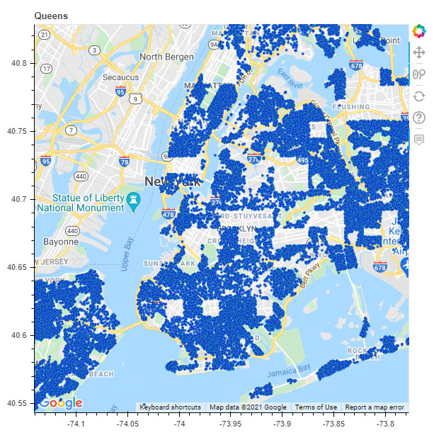
Homes in dataset

Slide 5
Data Wrangling
75,000 observations with over 1500 features
Shrunk to 65,000 homes and 24 features
Main variable – Price
Dropping of redundant, useless features and rows with missing values

Slide 6
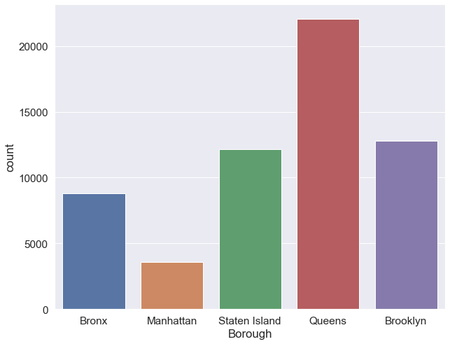
Location count

Slide 7
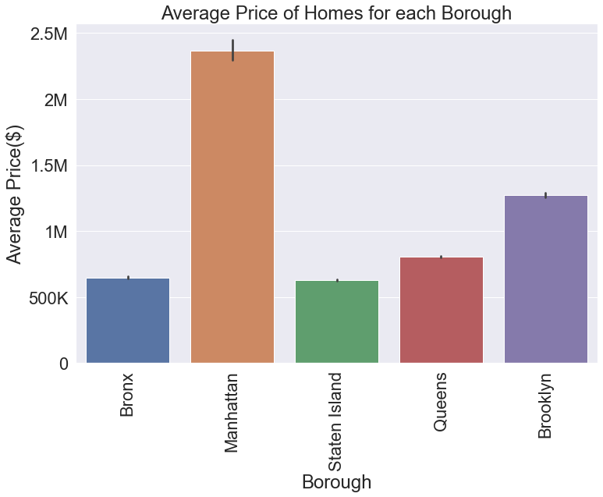
Location Impact

Slide 8
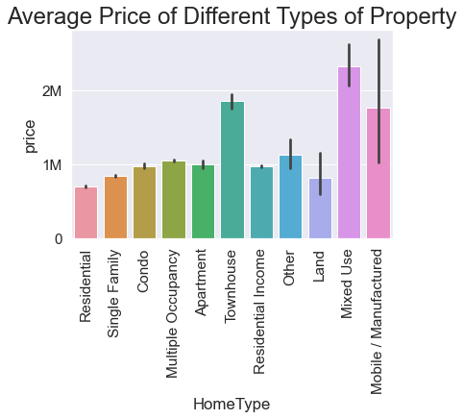
Property Type

Slide 9
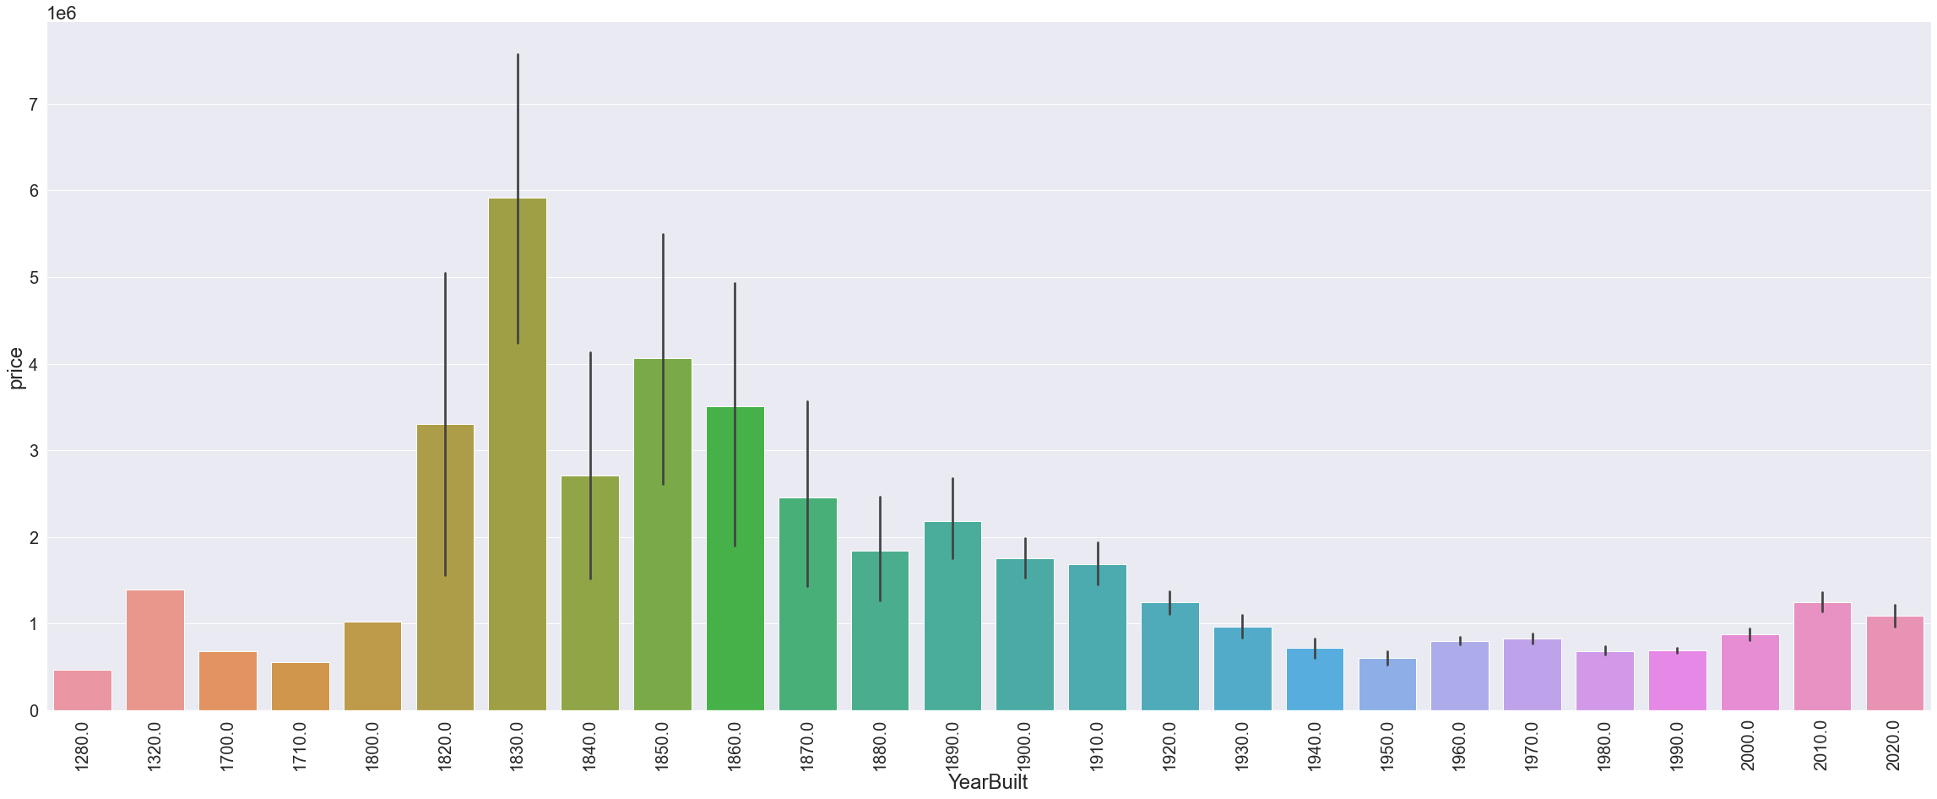
Impact of Built Year
70 % of homes in early 1800’s to 1900’s were in Manhattan or Brooklyn
Recent Homes see an uptick with over 50% of homes in lower priced boroughs

Slide 10
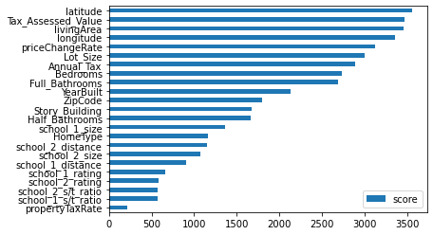
Most Impactful Features

Slide 11
Metrics for evaluation
MAE – Mean Absolute Error
On average how far is the prediction from the actual

Slide 12
Model Selection
Linear Regression
380K
K-Nearest Neighbor
261K
RandomForest
250K
XGBoost Regression
220K

Slide 13
Hyper-Parameter Tuning
Max_depth, min_child_weight, eta, subsample, and col_sample
Reduction of nearly 30K in MAE on testing data and 65.7K in training data.

Slide 14
Takeaways
Best results achieved via XGBoost
Location is the largest driving force of price
Multi-family homes and Townhouses have greater return
Newly built homes garner larger premium over old and remodeled homes

